Slide 1

The Offensive Python
Practical Python for Penetration Testing

Slide 2





Hi!
I am Satria Ady Pradana
Community Leader
of
Reversing.ID
xathrya
@xathrya
Reversing.ID
Revealing the Truth through Breaking Things

Slide 3
I am not going to teach you the basic of Python programming.
I am going to show you the power of python! ❤

Slide 4
1.
Why Python?
Packet crafting reverse engineering
Penetration testing machine learning
Cyber Security Forensic
Automation Exploit Development
Fuzzing
.
.
.
Wonder Why?

Slide 5

Why Python for cyber security?
Designed for rapid prototyping
Simple and clean structure, improve readability and ease of use.
Extensive library, also ease of interfacing
Widely adopted, most linux distro ship it by default
Which makes it ideal language for scripting and rapid development.

Slide 6
2.
Python Implementation
The Realm of Python

Slide 7
CPython (reference)
IronPython and FePy (run on top of .NET VM)
Jython (run on top of JVM / Java VM)
PyPy (python in python)
Many more…
See https://www.python.org/download/alternatives/

Slide 8
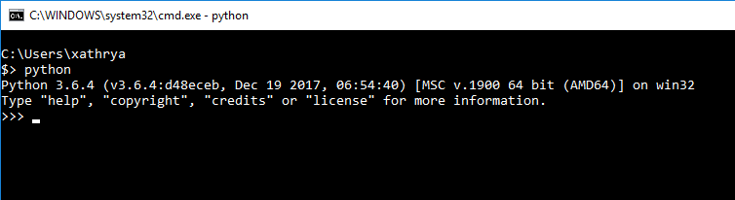
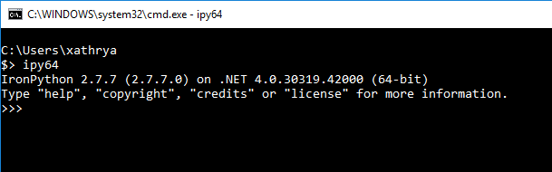
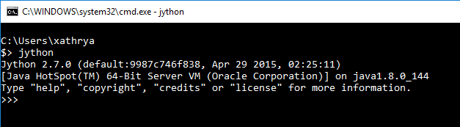

Slide 9
Picking the right tools for the jobs

Slide 10
3.
Warming Up
Let’s code
the
basic things

Slide 11
The root of cyber security is programming and networking with extra magic logic.

Slide 12
Let’s start by FUNdamental Things
Network (Server, Client)
Cryptography

Slide 13
Simple Servers
Host some files
Collect data
Relay informations
See Python3 http.server (https://docs.python.org/3/library/http.server.html)

Slide 14
Simple Client
Create malicious request
Dorking
Automatic requests sender
See
requests library (http://docs.python-requests.org/en/master/)
BeautifulSoup4 (https://www.crummy.com/software/BeautifulSoup/bs4/doc/)

Slide 15
Cryptography
Encrypt / Decrypt
Compute hash value
Some stuffs on certificate
See
PyCrypto library (https://www.dlitz.net/software/pycrypto/api/2.6/)

Slide 16
4.
Getting Advanced
Let’s code
More
FUN things

Slide 17
(Network) Packet Crafting
Scapy

Slide 18
What is Scapy?
Packet manipulation and decoder for python
send, sniff, dissect, and forge network packets
Handle most network tasks such as scanning, tracerouting, probing, fuzzing, network discovery.
The idea: sending packets and receiving answers.

Slide 19
Can “Replace” Tools
hping
arpspoof
arping,
p0f
Tcpdump & tshark
… etc
i.e: Create any flexible networking tools for any purpose

Slide 20
Used for
ARP Cache poisoning
Sending invalid frame
Injecting 802.11 frames
Combining techniques (ex: VLAN hopping + ARP cache poisoning)
… etc

Slide 21
Basic of Scapy
Each protocol has representation (i.e: Ether, ARP, TCP, IP, etc)
The component of each protocol can be modified (i.e: destination address, hardware address, etc)
A packet is a stack of protocols, as simple as concatenating with / (slash)
Packet can be sent from layer 3 (send) or layer 2 (sendp).

Slide 22
Starting Scapy (Interactive)
In command line
$ scapy
>>>
Or, in python REPL prompt
from scapy.all import *

Slide 23

(Reversing) Automated Bug Finder
Angr

Slide 24
What is angr?
A binary analysis framework
Framework for analyzing binaries
Combines static and dynamic symbolic analysis

Slide 25
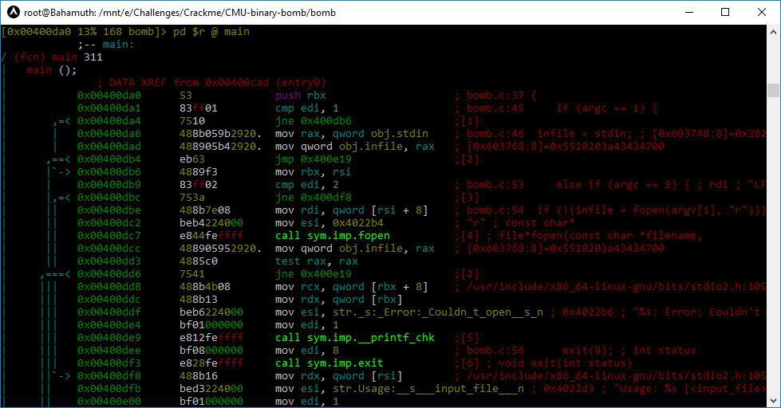
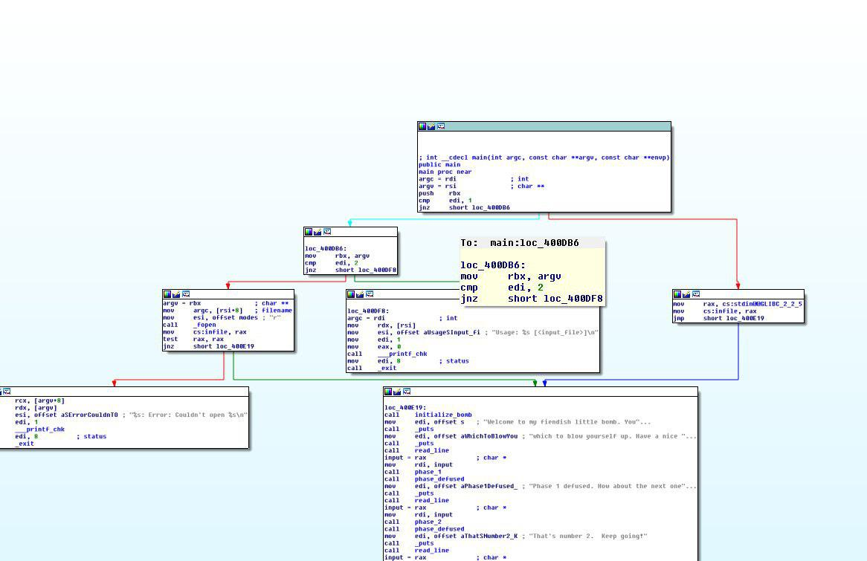
Which one is easier to read?

Slide 26
Program can be represented as graph for better exploration.
Complex operation can be decomposed / simplified.
Program is a flow of set (block) of instruction to another set of instruction.
We call it states
From this states, can we reach that state?

Slide 27
SURE !!!

